Slide 1
Introductory Statistics at the College Level—Making it More Exciting and Relevant
Elizabeth Johnson, George Mason University;
Stephanie Talbot, Montgomery College, Rockville Campus;
Bonnie Kegan, U.S. Census Bureau, University of Maryland, Baltimore County and Anne Arundel Community College
Washington Statistical Society Seminar
February 2, 2015

Slide 2
Next Statistics Education Seminar
Teaching precursors to data science in introductory and second courses in statistics
Nicholas J. Horton, Professor of Statistics, Amherst College
Tuesday, April 28, 2015
At Mathematica Policy Research
RSVP & More Details: Carol Joyce Blumberg at cblumberg@gmail.com

Slide 3
How to Get WSS Statistics Education Announcements
Contact Carol Joyce Blumberg at cblumberg@gmail.com to be added to a blinded email list.
Advantage– I send out seminar announcements as soon as they are ready and notices of a few other important statistics education events.

Slide 4
Joining WSS and American Statistical Association (ASA)
WSS—http://www.washstat.org/joinus.html. If not an ASA member, scroll down to Associate Member part near the bottom of the page.
ASA https://www.amstat.org/membership/becomeamember.cfm
K-12 Teachers—Special ASA 3-Month Free Trial Membership. For details, see https://www.amstat.org/membership/k12teachers/index.cfm?fuseaction=main

Slide 5
Organization of the Seminar
Speakers discuss what Topics should be covered in a “modern” introductory statistics course, as opposed to traditional one (< 20 min.)
Audience questions on Topics only (< 5 min.)
Speakers discuss use of Technology in “modern” introductory statistics course (< 39 min.)
Audience Discussion
Reception at East Street Café (mezzanine level of Union Station)

Slide 6
Disclaimer
The recommendations in this seminar are solely those of the presenters and not of the Washington Statistical Society or the American Statistical Association

Slide 7
Topics Covered
Order of Speakers
Stephanie Talbot
Bonnie Kegan
Elizabeth Johnson

Slide 8
Stephanie Talbot

Slide 9
General Statistics Course Content
I agree with the outline provided of topics covered in an elementary statistics course but would like us to consider the addition of the Binomial Distribution

Slide 10
Some talking points for addition of Binomial Distribution
Allows for investigation of discrete variables
Students are familiar with everyday “binomial” questions
Intuitive to students
Extending the analysis of binomial distributions through the approximation by the Normal distribution ( a nice connection to make)

Slide 11
Bonnie Kegan

Slide 12
How the Content Should be Changed
Focus on 4 major areas:
  Best practices for data collection
  Describing the data- graphically and numerically
  Probability/Normal Distribution
  Making data based conclusions

Slide 13
Best Practices for Data Collection
It is important for students to understand where the data come from and how to assess data quality
“Studies show…..”
  Students need to be taught to question the methods used to collect data to identify potential bias and to understand the role sample size plays
  Also worthwhile to discuss the role measurement plays in producing valid and reliable data

Slide 14
Describing the data
Students need to understand the pros/cons of different graphs and numerical summaries as well as how to select the appropriate graph or summary for the type of data they have and the purpose of the analysis
  Discussion of stem and leaf plots is unnecessary

Slide 15
Probability
Students really need only a basic understanding of probability
  Relative frequency
  Probability distribution models
  Basic addition property
  Understanding complements (and thus mutually exclusive events)

Slide 16
Normal distribution
Understanding the normal distribution is an important foundation for later discussions of inference- agree with standard coverage of this topic.
Discussion of sampling distributions and the Central Limit Theorem could be eliminated

Slide 17
Making Data-based Conclusions
A discussion of the logic of hypothesis testing is critical-even if students never learn how to calculate a test-statistic or a p-value.
Limitations of inference and the impact of sample size on the conclusions that can be made should also be emphasized.
I have never taught the Wilcoxon Rank Sum Test to intro students.

Slide 18
Elizabeth Johnson

Slide 19
Innovations?
Recently textbooks and applets have been developed that use randomization and bootstrapping techniques in introductory statistics classes.
Statistics educators such as Nathan Tintle ,Beth Chance, Allan Rossman, Jill VanderStoep, Patti Frazer Lock, Robin Lock, Kari Lock Morgan, Webster West, Roger Woodard and Christine Franklin along with others have developed computer software packages and textbooks that allows the language of statistical inference to be taught at the beginning of an introductory statistics course instead of at the end.

Slide 20
What is the appeal?
Traditional t – test
Randomization tests
Data collection and experimental design
Basic graphics
Summary Statistic: means and standard deviations
The normal distribution
  Calculate probabilities
  Use normal table
Sampling distributions and the Central Limit Theorem
  Distribution of the statistic
Basics of Hypothesis testing
  What is a p-value
  Hypothesis
T-distribution and t-test
  Using the t-table
Data collection and experimental design
Basic graphics
Summary Statistic - mean

Slide 21
How should topics be sequenced?
Lock and others suggest one way is to
  Start with data production - experiments, random samples, etc.
  Summarize with statistics and graphs
  Interval estimation (via bootstrap)
  Significance tests (via randomizations)
  Traditional approximations - normal, t-intervals, etc.
  More advanced inference - ANOVA, two-way tables, etc.

Slide 22
Another suggestion - introduce one parameter at a time?
Rossman, Chance and others suggest that students could study one scenario from beginning to end of statistical investigation process
Repeat (spiral) through various data scenarios as the course progresses

Slide 23
Concerns
How do you train teachers to use these new techniques?
How do you assess your students?
Do these methods increase understanding or just add to their confusion?
If this is a service course, do the other departments only want the traditional approaches taught? If so that may cause other departments to develop their own introductory statistics courses

Slide 24
Technology
Order of Speakers
Bonnie Kegan
Elizabeth Johnson
Stephanie Talbot

Slide 25
Bonnie Kegan

Slide 26
Role of Technology
For students who find mathematics difficult use of technology plays an important role in making statistics more accessible.
Options
  Statcrunch (www.statcrunch.com)
  Graphing Calculators
  Excel

Slide 27
Role of Non-lecture Teaching Methods
To learn statistics, students have to DO statistics.
Students should be given hands on opportunities to
  Collect data, choose a sample, plan an experiment
  Formulate a research question and identify the key variables
  Describe variable distributions graphically and numerically
  Determine appropriate inference and interpret the results in a meaningful way.

Slide 28
Role of Non-lecture Teaching Methods
Students should be allowed to work in small groups
Students should be given the opportunity to “talk statistics” in a presentation or paper.
Biggest challenge: choosing activities that align with course objectives and grab student’s interest.

Slide 29
STATCRUNCH HIGHLIGHTS
Data can be uploaded from a file or you can use the drag and drop feature for files.
Surveys can be created and the results easily viewed in the data table for analysis
Data, analysis results, surveys and reports can all be saved and shared.
Students can create and join groups to share data, results, reports, and surveys

Slide 30
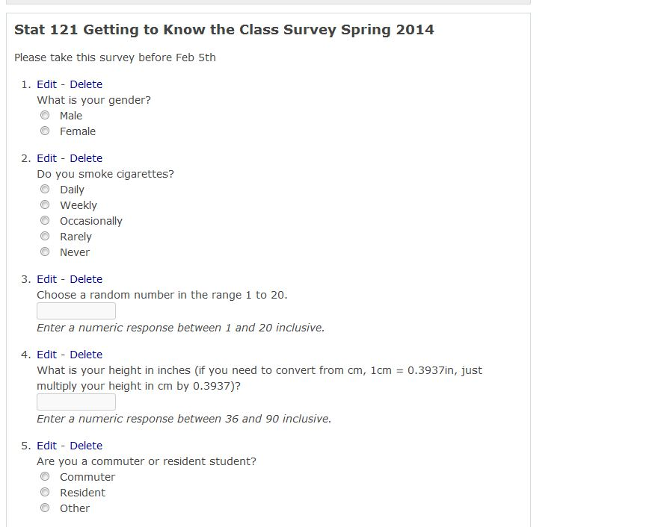
STATCRUNCH: SURVEY CREATION

Slide 31
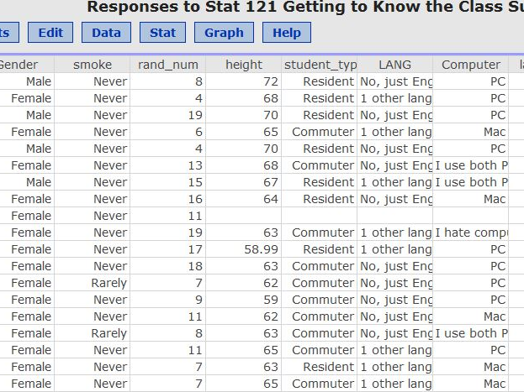
STATCRUNCH: Data Table

Slide 32
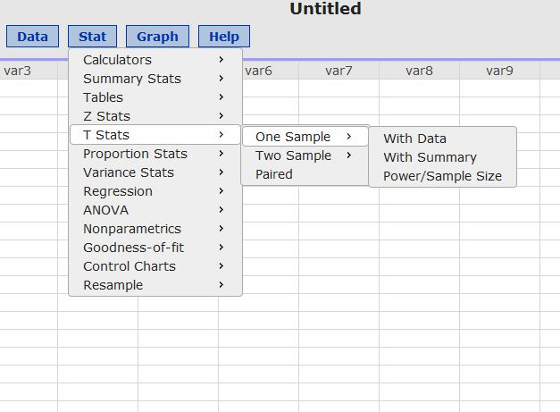
STATCRUNCH: STAT MENU

Slide 33
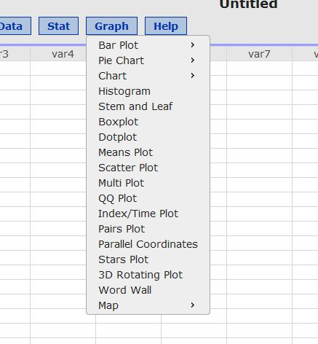
STATCRUNCH:GRAPH MENU

Slide 34
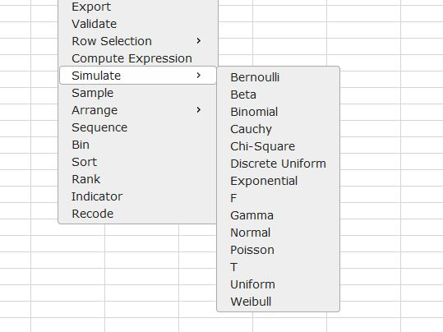
STATCRUNCH: DATA MENU-SIMULATION

Slide 35
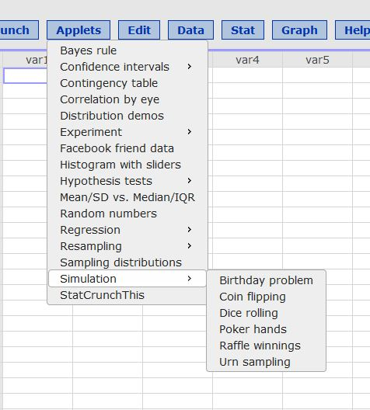
STATCRUNCH: APPLETS

Slide 36
Role of Non-lecture Teaching Methods
To learn statistics, students have to DO statistics.
Students should be given hands on opportunities to
  Collect data, choose a sample, plan an experiment
  Formulate a research question and identify the key variables
  Describe variable distributions graphically and numerically
  Determine appropriate inference and interpret the results in a meaningful way.

Slide 37
Elizabeth Johnson

Slide 38
Content and Technology Changes in Introductory Statistics Classes
While many of the basic topics covered in introductory courses has not changed over the past 30 years, the method in which these topics is taught has changed drastically.
In my first college level business statistic course (many, many years ago) we did not have computer assignments or powerful hand-held calculators so all calculations were done ‘by-hand’ using tables – lots of tables!
So we learned all the calculations but we may have lacked obtaining a solid conceptual understanding of these topics.

Slide 39
Calculators, Computers and the Internet--Oh my!
The introduction of technology shifted the classroom focus to teaching students how to use different technologies to perform the calculations. But we still had to teach the tables – how else could we assess their skills and assign a course grade?
This doubled our work and still did not leave time to stress the issue of conceptual understanding of statistical ideas.
Some schools therefore decided to teach the introductory statistics class using two levels – a lower level class that stressed conceptual understanding (but with very little ‘math’) AND an upper level class that focused more on the ‘math’ and computing.
Can we have both??

Slide 40
How? Teaching the concepts with applets
There are many nicely developed programs, such as
http://www.lock5stat.com/statkey/index.html
http://math.hope.edu/isi/
http://www.statcrunch.com/
MUST ALWAYS MAKE THE CONNECTION BETWEEN THE STUDY AND THE SIMULATION SO STUDENTS DO NOT FORGET THE POINT OF THE ACTIVITY

Slide 41
Stephanie Talbot

Slide 42
Making Statistics understandable and believable using technology
Fathom software has now become share ware and provides an ideal platform for elementary statistics students to investigate data.
Demo on Fathom : Sampling distributions– really understanding and believing the power of sampling distributions in estimating population parameters.

Slide 43
How to Get Fathom
Fathom is free of cost until at least June 2015. Go to:
http://concord.org/fathom-dynamic-data-software

Slide 44
Tinkerplots
Tinkerplots is shareware equivalent of Fathom for elementary and middle school students
Used in introductory statistics courses for elementary and middle school teachers
Download url:
http://www.tinkerplots.com/download

