Slide 1
Using Paradata for Monitoring Interviewer Performance in Telephone Surveys
Emilia Peytcheva, RTI International
Andy Peytchev, University of Michigan

Slide 2
Acknowledgements
Howard Speizer
Kelly Castleberry
Tamara Terry
T.J. Nesius
Marion Schultz
Marcus Berzofsky

Slide 3
Outline
Why model paradata
Present objective
Approach in centralized call center setting
History
  2010 implementation
    Statistical model
    Graphing
    Tabulation
  2014-2015 randomized experiment
  2016- current and future work to enrich the set of metrics

Slide 4
Paradata
Raw paradata have limited utility
  Raw: Number of interviews from the full sample
  Modelled: AAPOR RR#3
  Raw: Daily interviewing hours
  Modelled: Daily hours per interview, by interviewer

Slide 5
Objective
Interviewer administered surveys rely extensively on the ability to:
  Identify lowest performing interviewers and take corrective actions
  Do so soon after the interviewer starts working on the study

Slide 6
Interviewer Performance Monitoring
Supervisors track hours per complete, response rates, refusal rates, and other similar metrics by interviewer
Even in centralized call center settings, sample cases are not randomly assigned to interviewers
Current practice: use “raw” paradata
Supervisor have to take into account that there may be alternative explanations for an interviewer’s poor performance measures, e.g.:
  She worked difficult shifts
  She was experienced and therefore assigned to work prior refusals
  She worked Spanish language cases

Slide 7
Model-Based Interviewer Performance
Key objective: rate of obtaining interviews
Usual metric: hours per interview
Model-based alternative: ratio of the rate of obtaining interviews to the expected rate of obtaining interviews

Slide 8
Expected Rate of Obtaining Interviews
Estimate the likelihood of obtaining an interview on each call attempt and aggregate to the interviewer level
Control for major departures from random assignment of cases to interviewers
  Time of day and day of week (i.e., shift)
  Prior refusal (i.e., refusal queue)
  Appointment
  Number of call attempts

Slide 9
Implementation (2010)
National dual-frame landline and cell phone RDD survey
Separate reports for landline and cell phone samples
  Many interviewers worked on both samples, but some could do better on one sample than the other
Started excluding bilingual interviewers
  Exhibited substantially different performance

Slide 10
Implementation (2010) continued
The interviewer performance report has multiple goals
  Identify lowest performers
  Identify improvement of lowest performers
All models estimated twice
  Cumulative data
  Weekly data only

Slide 11
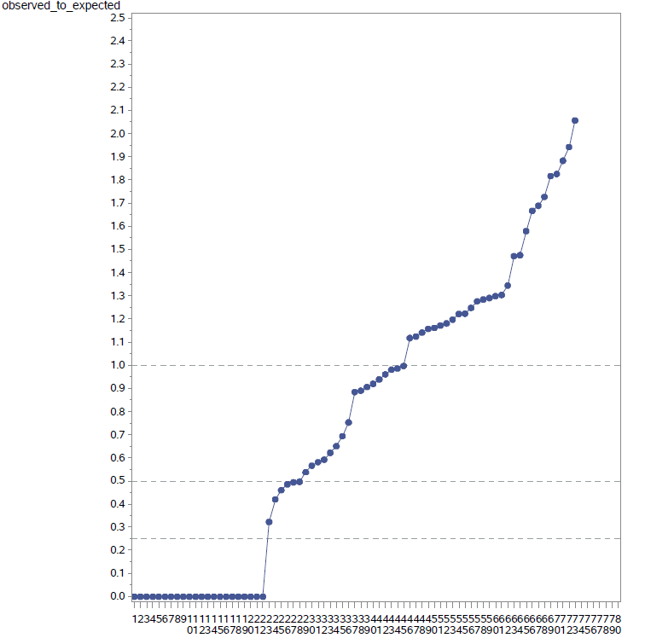
Graphical Display

Slide 12
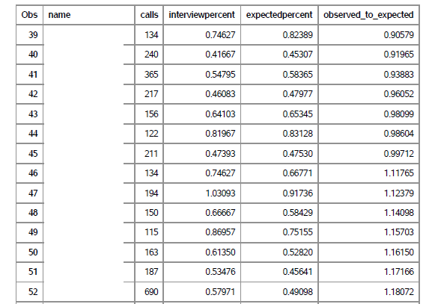
Tabular Display

Slide 13
Adoption (2010-2013)
Initial period during which supervisors tracked the usual raw paradata-based metrics and the model-based interviewer performance metrics in parallel
Over time, adoption of the model-based metrics along with the addition of reference performance thresholds led to:
  consistent identification of interviewers
  follow-up after intervention using the same standardized metrics

Slide 14
Experiment (2014-2015)
General finding that interviewer training (and feedback) can help lowest performing interviewers (Groves and McGonagle, 2001)
By modeling the paradata to evaluate interviewer performance, could we:
  Increase the average interviewer performance?
  Reduce the variability in interviewer performance (by more accurately and quickly identifying the lowest performing interviewers)?

Slide 15
Experimental Design
Randomly assign interviewers to a control and an experimental condition
  Control: Feedback based on standard (non-modeled paradata) report
  Experimental: Use an additional report with a model-based estimate of interviewer performance
Provide feedback to lowest-performing fifth of interviewers identified in each condition

Slide 16
Results – Average Interviewer Performance
n.s. (test performed on log-transformed ratio)

Slide 17
Results – Variability in Interviewer Performance across Interviewers
n.s.

Slide 18
Summary and Conclusions
For both outcomes (average performance and variability across interviewers) differences were in the expected directions, but not significant (and relatively small)
Results were very similar across both types of samples (landline and cell phone)
We interpret these results as encouraging, providing impetus for further development and investigation

Slide 19
Next Steps
Identifying lower-performing interviewers early in data collection is essential, but not sufficient in addressing performance; similar experimentation is needed to identify more effective feedback and other interventions

Slide 20
Current Phase 2016-
Need multiple paradata-based metrics for each interviewer to address:
  Efficiency
  Nonresponse
  Measurement error
Develop and implement other metrics, and augment the interviewer performance report
  Refusal rates
  Data quality measures (e.g., item nonresponse rates)
  Coded interviewer behaviors from monitoring sessions

Slide 21
In-Person Interview Surveys
This model relies on correcting for departures from randomization (the quasi-randomization in centralized call centers)
How well could such paradata-based models correct for lack of any randomization in face to face surveys?
Models have been developed, but not tested:
  West and Groves (2013)
  Erdman, Adams, and O’Hare (2016)

Slide 22
Thank you
Emilia Peytcheva
epeytcheva@rti.org

