Slide 1
Think beyond the Curbstone
Taking Fabrication Detection and Prevention
Beyond the Interviewer Level
Steve Koczela
12/2/2014, WSS

Slide 2
Beyond the curbstone?
Quality control problems appear to extend beyond the interviewer, but most published detection methods focus on the interviewer and “curbstoning” or “interviewers’ deviations”
Computers appear to be in use for creating or duplicating data rather than collecting it, but most methods focus on human factors
There is an apparent lack of basic quality control processes and a lack of awareness regarding the warning signs of problematic data

Slide 3
Prevalence of duplicate cases
Duplicates easy to spot with stats programs, but finding them is a routine quality control step that is often missed
There are many examples of these patterns in datasets available online, sponsored by survey research heavyweights
Case | Country | Duplicates | Variables in duplicated data
Survey 1 | County A Country B | 777 of 1,182 total 208 of 750 total | 180 180
Survey 2 | Country C | 230 of 850 cases | 78
Survey 3 | Country D | 1,774 of 2,669 cases | 66

Slide 4
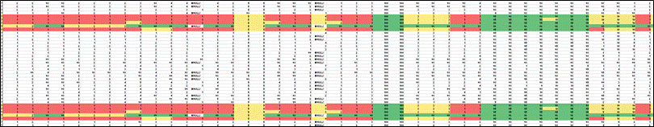
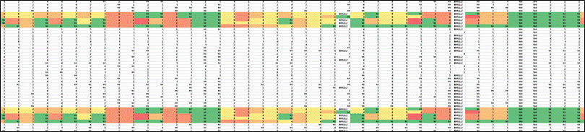
Duplicates as a set
Duplicated “sets” suggest cut and paste of whole blocks of interviews

Slide 5
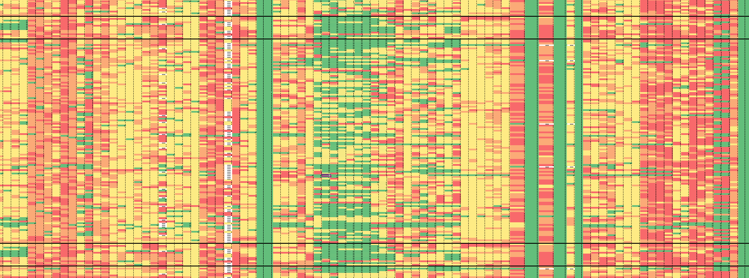
Duplicates as a set
Here, a set of 13 consecutive cases is duplicated
Suggests someone with access to the data-file is cutting and pasting whole blocks of interviews

Slide 6
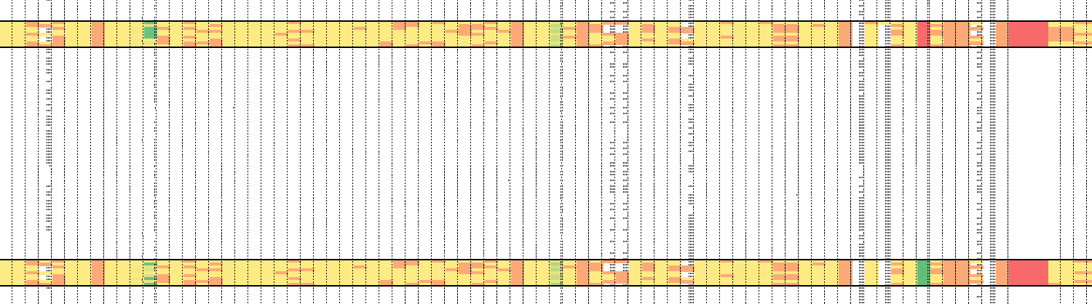
Cut and paste
Here, blocks of data are cut and paste, but not in a way that creates full duplicates
Arrows show differences between cases, though major
segments of the 2 data blocks are identical

Slide 7
Suggestions
Require detailed administrative data for each record including all persons responsible for each line of data
  Interviewer, keypuncher, supervisor, start/stop time, PSU, back-check type (if any), manager, region, etc.
  Any level at which data is collected, processed, or verified
Run quality control checks for every level of staff
Research sponsors should add their own checks to supplement contractor-led quality control efforts

Slide 8
