Slide 1
Statistics Education as part of the Common Core: What, Why, and How?
Doug Tyson Central York High School, York, PA

Slide 2
Announcements
February—Introductory Statistics Content and Use of Technology—Panel of 2 or 3 speakers
April—Nicholas Horton (Amherst College)—Integrating Data Science into the Statistics Curriculum

Slide 3
Announcements
Joining ASA and WSS
ASA K-12 Membership—Bargain of the Century
Only $50 per year—Get Journals & Newsletters http://www.amstat.org/membership/becomeamember.cfm
3-Month Free membership at http://www.amstat.org/membership/K12teachers
Forms available in this room or at the URLs given here

Slide 4
Announcements
Joining ASA and WSS
WSS Membership
Helps support Statistics Education and other activities
Only $10 per year http://washstat.org/documents/wss_brochure_20140926.pdf
Forms available in this room or at the URLs given here

Slide 5
Announcements
If you want to receive notices of future WSS Statistics Education Activities, please email Carol Joyce Blumberg at cblumberg@gmail.com

Slide 6
Beginnings
Who am I?
The 3 “B”s of public speaking
Standing on the shoulders of giants
Who are you?
Teachers? (College or HS?)
Statisticians?

Slide 7
Framing the Discussion
“Even if you believe that every student can’t learn Statistics, I believe school policy should operate as if they can.”
- Zalman Usiskin

Slide 8
The Plan
Address the role of statistics and probability in the curriculum (why)
Give an overview the Common Core Standards for Statistics (what)
Present two or three activities (in brief) that can be used to address some of the CCSS standards and the pedagogy behind teaching statistics/probability (how)

Slide 9
Statistics Education as part of the Common Core:
WHY?
Doug Tyson Central York High School, York, PA

Slide 10
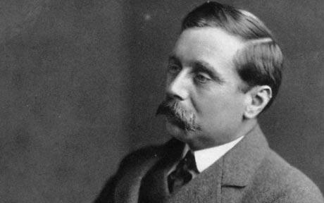
Why Should We Teach Statistics?
“Statistical thinking will one day be as necessary for efficient citizenship as the ability to read and write.” -H.G. Wells
“That day is upon us.” -Doug Tyson

Slide 11
Dueling Polls: A Case Study
More teachers are souring on Common Core, finds one survey (Source: http://hechingerreport.org/content/teachers-souring-common-core-finds-one-survey_17581/)
“The percentage of teachers who are enthusiastic about Common Core – a set of academic guidelines in math and English that more than 40 states have adopted – is down from 73 percent last year to 68 this year, according to a poll of 1,600 teachers across the country.”

Slide 12
Dueling Polls: A Case Study
From the comments in the previous article:
“A recent survey in EdWeek.com had much sharper declines in teacher approval of Common Core. Additionally, consider the sponsers [sic] of this survey–the Gates Foundation and Scholastic: the first paid for the development of the CC and the second will profit in the 100s of millions from publications and online programs. Take this survey with a big block of salt and don’t be soft-peddled!”

Slide 13
Dueling Polls: A Case Study
No Common Opinion on the Common Core (Source: http://educationnext.org/2014-ednext-poll-no-common-opinion-on-the-common-core/)
“Teachers, too, have soured on the Common Core (see Figure 1). Just a year ago, 76% of teachers backed the Common Core, but the portion in favor has now plummeted to 46%.”

Slide 14
Who has the Real Answer?

Slide 15
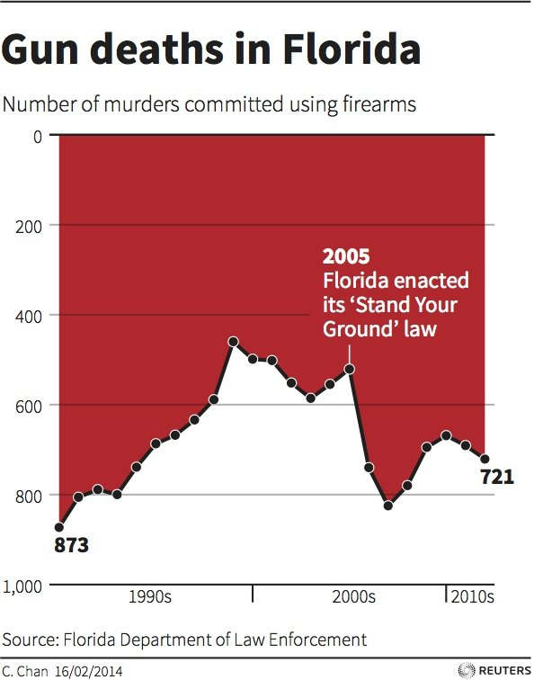
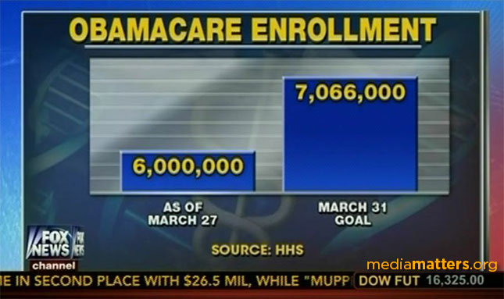
Poor Graphs

Slide 16
Social Justice
Commission meeting held after complaints of racism in local school (Source: http://www.wgal.com/news/complaints-of-racism-at-susquehanna-valley-school-prompt-state-meeting/28183788)
“With black and white students about equal in numbers two years ago, now over 69 percent of in-school suspensions went to black students as opposed to almost 17 percent for whites. 62 percent of out-of-school suspensions were to black students, while whites accounted for only 20 percent.”

Slide 17
Social Justice
Statistics can not prove discrimination, but can detect patterns consistent with its practice.
- Dick Scheaffer

Slide 18
CCSS Statistics: Why?
Data analysis, inference, and prediction are increasingly important in all areas of our culture.
We need citizens that can think intelligently about randomness, variability, and error.
We need to know what data and Statistics tells us and what it doesn’t tell us.

Slide 19
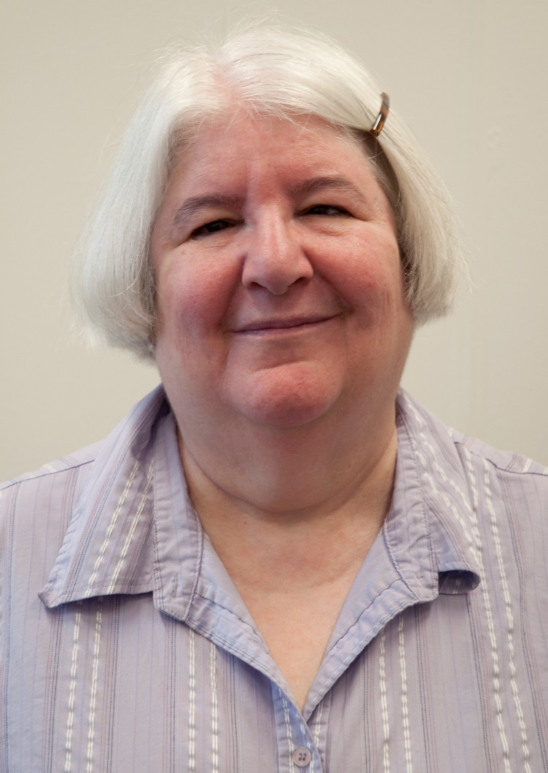
Summary
“You’re preaching to the choir.”
- Carol Blumberg

Slide 20
Statistics Education as part of the Common Core:
WHAT?
Doug Tyson Central York High School, York, PA

Slide 21
What Content Should We Teach?
“Many mathematics teachers are uncomfortable with Statistics. They call it Sadistics, you know.“
- Zalman Usiskin

Slide 22
What Content Should We Teach?
“I want students in an intro course to leave thinking Statistics is relevant, intuitive, and cool [emphasis added].“
-Dick De Veaux

Slide 23
The Common Core Initiative
The Common Core Initiative
Mathematics
English Language Arts/Literacy
College & career readiness
Full set of statistics standards

Slide 24
Whence the Common Core Standards?
“The state-led effort to develop the Common Core State Standards was launched in 2009 by state leaders, including governors and state commissioners of education from 48 states, two territories and the District of Columbia, through their membership in the National Governors Association Center for Best Practices (NGA Center) and the Council of Chief State School Officers (CCSSO).”

Slide 25
CCSS Standards Organization
Common Core Standards
English Language Arts/ Literacy
Mathematics
Process Standards
Content Standards

Slide 26
Shifts in Mathematics
Shifts in Mathematics Education, according to CCSS:
Greater focus on fewer topics
Coherence: Linking topics and thinking across grades
Rigor: Pursue conceptual understanding, procedural skills and fluency, and application with equal intensity

Slide 27
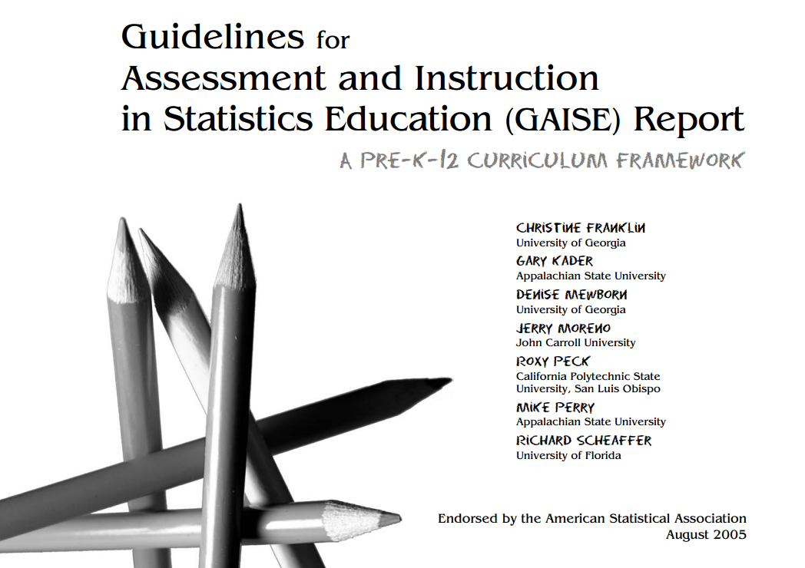
GAISE Report
Whence the Statistics standards?
The (ASA endorsed) GAISE Report for PreK-12, with modifications (2005)

Slide 28
WARNING!
CCSS approaches statistics and probability from a frequentist point-of-view.
CCSS ≠ standardized testing.
Lots of text ahead.
Text size may vary.

Slide 29
Statistics and Probability: Grades 6 – 8 Overview
Grade 6
Develop understanding of statistical variability.
Grade 7
Grade 8
Summarize and describe distributions.
Use random sampling to draw inferences about a population.
Draw informal comparative inferences about two populations.
Investigate chance processes and develop, use, and evaluate probability models.
Investigate patterns of association in bivariate data.

Slide 30
Statistics and Probability: 6th Grade
Develop understanding of statistical variability.
CCSS.MATH.CONTENT.6.SP.A.1 Recognize a statistical question as one that anticipates variability in the data related to the question and accounts for it in the answers. For example, "How old am I?" is not a statistical question, but "How old are the students in my school?" is a statistical question because one anticipates variability in students' ages.
CCSS.MATH.CONTENT.6.SP.A.2 Understand that a set of data collected to answer a statistical question has a distribution which can be described by its center, spread, and overall shape.

Slide 31
Statistics and Probability: 6th Grade
Summarize and describe distributions.
CCSS.MATH.CONTENT.6.SP.B.5 Summarize numerical data sets in relation to their context, such as by:
Giving quantitative measures of center (median and/or mean) and variability (interquartile range and/or mean absolute deviation), as well as describing any overall pattern and any striking deviations from the overall pattern with reference to the context in which the data were gathered.

Slide 32
Statistics and Probability: 7th Grade
Use random sampling to draw inferences about a population.
CCSS.MATH.CONTENT.7.SP.A.1 Understand that statistics can be used to gain information about a population by examining a sample of the population; generalizations about a population from a sample are valid only if the sample is representative of that population. Understand that random sampling tends to produce representative samples and support valid inferences.
CCSS.MATH.CONTENT.7.SP.A.2 Use data from a random sample to draw inferences about a population with an unknown characteristic of interest. Generate multiple samples (or simulated samples) of the same size to gauge the variation in estimates or predictions. For example, estimate the mean word length in a book by randomly sampling words from the book; predict the winner of a school election based on randomly sampled survey data. Gauge how far off the estimate or prediction might be.

Slide 33
Statistics and Probability: 7th Grade
Draw informal comparative inferences about two populations.
CCSS.MATH.CONTENT.7.SP.B.3 Informally assess the degree of visual overlap of two numerical data distributions with similar variabilities, measuring the difference between the centers by expressing it as a multiple of a measure of variability. For example, the mean height of players on the basketball team is 10 cm greater than the mean height of players on the soccer team, about twice the variability (mean absolute deviation) on either team; on a dot plot, the separation between the two distributions of heights is noticeable.
CCSS.MATH.CONTENT.7.SP.B.4 Use measures of center and measures of variability for numerical data from random samples to draw informal comparative inferences about two populations. For example, decide whether the words in a chapter of a seventh-grade science book are generally longer than the words in a chapter of a fourth-grade science book.

Slide 34
Statistics and Probability: 7th Grade
Investigate chance processes and develop, use, and evaluate probability models.
CCSS.MATH.CONTENT.7.SP.C.7 Develop a probability model and use it to find probabilities of events. Compare probabilities from a model to observed frequencies; if the agreement is not good, explain possible sources of the discrepancy.

Slide 35
Statistics and Probability: 7th Grade
Investigate chance processes and develop, use, and evaluate probability models.
CCSS.MATH.CONTENT.7.SP.C.8 Find probabilities of compound events using organized lists, tables, tree diagrams, and simulation.
Design and use a simulation to generate frequencies for compound events. For example, use random digits as a simulation tool to approximate the answer to the question: If 40% of donors have type A blood, what is the probability that it will take at least 4 donors to find one with type A blood?

Slide 36
Statistics and Probability: 8th Grade
Investigate patterns of association in bivariate data.
CCSS.MATH.CONTENT.8.SP.A.2 Know that straight lines are widely used to model relationships between two quantitative variables. For scatter plots that suggest a linear association, informally fit a straight line, and informally assess the model fit by judging the closeness of the data points to the line.

Slide 37
Statistics and Probability: 8th Grade
Investigate patterns of association in bivariate data.
CCSS.MATH.CONTENT.8.SP.A.3 Use the equation of a linear model to solve problems in the context of bivariate measurement data, interpreting the slope and intercept. For example, in a linear model for a biology experiment, interpret a slope of 1.5 cm/hr as meaning that an additional hour of sunlight each day is associated with an additional 1.5 cm in mature plant height.

Slide 38
Statistics and Probability: 8th Grade
Investigate patterns of association in bivariate data.
CCSS.MATH.CONTENT.8.SP.A.4 Understand that patterns of association can also be seen in bivariate categorical data by displaying frequencies and relative frequencies in a two-way table. Construct and interpret a two-way table summarizing data on two categorical variables collected from the same subjects. Use relative frequencies calculated for rows or columns to describe possible association between the two variables. For example, collect data from students in your class on whether or not they have a curfew on school nights and whether or not they have assigned chores at home. Is there evidence that those who have a curfew also tend to have chores?

Slide 39
Statistics and Probability: High School Overview
Interpreting Categorical and Quantitative Data (S-ID)
Summarize, represent, and interpret data on a single count or measurement variable
Summarize, represent, and interpret data on two categorical and quantitative variables
Interpret linear models
Making Inferences and Justifying Conclusions (S-IC)
Understand and evaluate random processes underlying statistical experiments
Make inferences and justify conclusions from sample surveys, experiments and observational studies

Slide 40
Statistics and Probability: High School Overview
Conditional Probability and the Rules of Probability (S-CP)
Understand independence and conditional probability and use them to interpret data
Use the rules of probability to compute probabilities of compound events in a uniform probability model
Using Probability to Make Decisions (S-MD)
Calculate expected values and use them to solve problems
Use probability to evaluate outcomes of decisions

Slide 41
Statistics and Probability: S-ID
Summarize, represent, and interpret data on a single count or measurement variable
CCSS.MATH.CONTENT.HSS.ID.A.4 Use the mean and standard deviation of a data set to fit it to a normal distribution and to estimate population percentages. Recognize that there are data sets for which such a procedure is not appropriate. Use calculators, spreadsheets, and tables to estimate areas under the normal curve.

Slide 42
Statistics and Probability: S-ID
Summarize, represent, and interpret data on two categorical and quantitative variables
CCSS.MATH.CONTENT.HSS.ID.B.5 Summarize categorical data for two categories in two-way frequency tables. Interpret relative frequencies in the context of the data (including joint, marginal, and conditional relative frequencies). Recognize possible associations and trends in the data.
CCSS.MATH.CONTENT.HSS.ID.B.6 Represent data on two quantitative variables on a scatter plot, and describe how the variables are related.
Informally assess the fit of a function by plotting and analyzing residuals.

Slide 43
Statistics and Probability: S-ID
Interpret linear models
CCSS.MATH.CONTENT.HSS.ID.C.9 Distinguish between correlation and causation.

Slide 44
Statistics and Probability: S-IC
Understand and evaluate random processes underlying statistical experiments
CCSS.MATH.CONTENT.HSS.IC.A.1 Understand statistics as a process for making inferences about population parameters based on a random sample from that population.
CCSS.MATH.CONTENT.HSS.IC.A.2 Decide if a specified model is consistent with results from a given data-generating process, e.g., using simulation. For example, a model says a spinning coin falls heads up with probability 0.5. Would a result of 5 tails in a row cause you to question the model?

Slide 45
Statistics and Probability: S-IC
Make inferences and justify conclusions from sample surveys, experiments, and observational studies
CCSS.MATH.CONTENT.HSS.IC.B.3 Recognize the purposes of and differences among sample surveys, experiments, and observational studies; explain how randomization relates to each.
CCSS.MATH.CONTENT.HSS.IC.B.4 Use data from a sample survey to estimate a population mean or proportion; develop a margin of error through the use of simulation models for random sampling.
CCSS.MATH.CONTENT.HSS.IC.B.5 Use data from a randomized experiment to compare two treatments; use simulations to decide if differences between parameters are significant.

Slide 46
Statistics and Probability: S-CP
Understand independence and conditional probability and use them to interpret data
CCSS.MATH.CONTENT.HSS.CP.A.4 Construct and interpret two-way frequency tables of data when two categories are associated with each object being classified. Use the two-way table as a sample space to decide if events are independent and to approximate conditional probabilities. For example, collect data from a random sample of students in your school on their favorite subject among math, science, and English. Estimate the probability that a randomly selected student from your school will favor science given that the student is in tenth grade. Do the same for other subjects and compare the results.
CCSS.MATH.CONTENT.HSS.CP.A.5 Recognize and explain the concepts of conditional probability and independence in everyday language and everyday situations. For example, compare the chance of having lung cancer if you are a smoker with the chance of being a smoker if you have lung cancer.

Slide 47
Statistics and Probability: S-CP
Use the rules of probability to compute probabilities of compound events
CCSS.MATH.CONTENT.HSS.CP.B.6 Find the conditional probability of A given B as the fraction of B's outcomes that also belong to A, and interpret the answer in terms of the model.
CCSS.MATH.CONTENT.HSS.CP.B.7 Apply the Addition Rule, P(A or B) = P(A) + P(B) - P(A and B), and interpret the answer in terms of the model.

Slide 48
Statistics and Probability: S-MD
Calculate expected values and use them to solve problems
CCSS.MATH.CONTENT.HSS.MD.A.1 (+) Define a random variable for a quantity of interest by assigning a numerical value to each event in a sample space; graph the corresponding probability distribution using the same graphical displays as for data distributions.
CCSS.MATH.CONTENT.HSS.MD.A.4 (+) Develop a probability distribution for a random variable defined for a sample space in which probabilities are assigned empirically; find the expected value. For example, find a current data distribution on the number of TV sets per household in the United States, and calculate the expected number of sets per household. How many TV sets would you expect to find in 100 randomly selected households?

Slide 49
Statistics and Probability: S-MD
Use probability to evaluate outcomes of decisions
CCSS.MATH.CONTENT.HSS.MD.B.5 (+) Weigh the possible outcomes of a decision by assigning probabilities to payoff values and finding expected values.
CCSS.MATH.CONTENT.HSS.MD.B.7 (+) Analyze decisions and strategies using probability concepts (e.g., product testing, medical testing, pulling a hockey goalie at the end of a game).

Slide 50
Statistics Education as part of the Common Core:
HOW?
Doug Tyson Central York High School, York, PA

Slide 51
How Should We (NOT) Teach Statistics?
“Shorn of all subtlety and led naked out of the protective fold of educational research literature, there comes a sheepish little fact: lectures don’t work nearly as well as many of us would like to think.” – George Cobb

Slide 52
Course Sequencing
The Common Core is flexible with regard to pathways for delivering Mathematics Content.
(Source: http://www.corestandards.org/assets/CCSSI_Mathematics_Appendix_A.pdf)

Slide 53
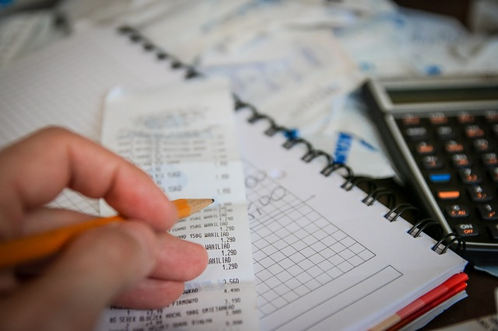
Teaching Practices
We need less emphasis on skill, more concept.
I DIDN’T SAY NO SKILLS!
If your goal is to make a student faster and more accurate than an electronic calculator, you’ve already failed.

Slide 54
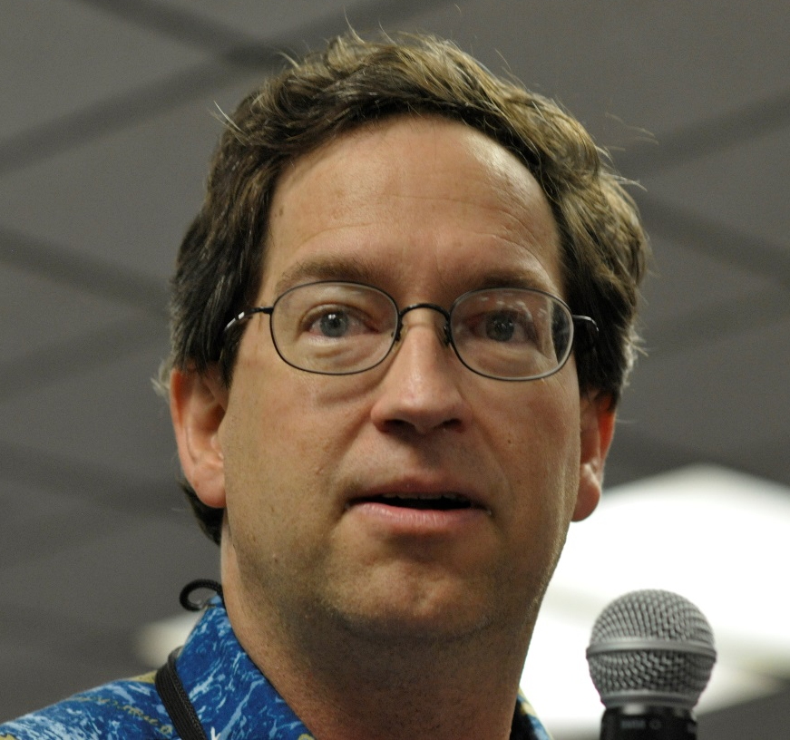
Day to Day Classroom Practice
Provide engaging, deep tasks.
Have students DO Statistics.
“Ask good questions!” – Allan Rossman

Slide 55
Day to Day Classroom Practice
Students are inquisitive because they are humans. If you get out of the way and let the data speak for themselves, students will be interested.
Think well, think deeply, think often.

Slide 56
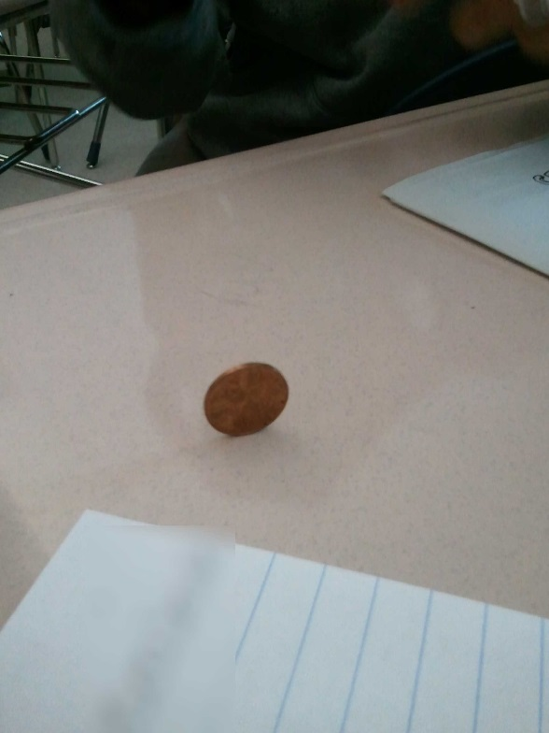
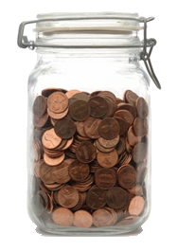
Two Activities: Show Me The Money
Is this Penny Fair?
Show Me the Money

Slide 57
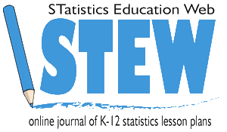
Some Resources
STEW (ASA)
Illuminations (NCTM)
ThisIsStatistics (ASA)
Stats In Schools (Census Bureau)
CAUSEWeb (NSF Grant)
Against All Odds (Video Series)
LOCUS (NSF Grant)

Slide 58
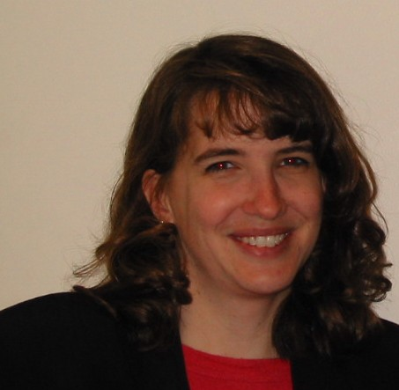
How Will We Know if We’ve Succeeded?
“The number one mantra to remember when designing assessment instruments is: Assess what you value.” – Beth Chance

Slide 59
Standardized Testing
PARCC vs. Smarter Balanced
Checking both websites for example high school items, I’ve found only one that is directly about Statistics (not just Algebra in disguise)
The Green Tea Study

Slide 60
My Deepest Fear
My deepest fear is that we’re not going to assess Statistics and Probability standards, and then we’ll lose the momentum we’ve gained in making Statistical Education a part of the standard curriculum for all students.

Slide 61
My Greater Hope
We are closer than we’ve ever been to having Statistics Education become a fundamental part of our school curriculum. It’s an exciting time to be a Statistics Educator.

Slide 62
Contact Information
Doug Tyson
Central York School District, York, PA
Come to my classroom. Please!
MrTysonStats.com
tyson.doug@gmail.com
Twitter: @tyson_doug
Facebook: tyson.doug
Linked In: tyson.doug

Slide 63
Reminder!
If you want to receive notices of future WSS Statistics Education Activities, please email Carol Joyce Blumberg at cblumberg@gmail.com

