Slide 1
Integrating Administrative Records and Commercial Data Sources into HUD's Housing Surveys: Past, Present, and Future
Shawn Bucholtz
Director, Housing and Demographic Analysis
Office of Policy Development and Research
U.S. Department of Housing and Urban Development
____________________________________________
September 17, 2014
The views expressed are those of the presenter and not necessarily those of the U.S. Department of Housing and Urban Development or the U.S. Government.

Slide 2
HUD Surveys
American Housing Survey (AHS)
Rental Housing Finance Survey (RHFS)
Survey owners of single family and multifamily rental properties
Neighborhood characteristics
Mortgage/Rent
Ownership
Assessment and taxes
Cross-sectional
Questions:
Ownership and configuration
Mortgage
Survey housing units
Structural characteristics
Limited structural
Purchase date and price
Purchase date and price
Assessment and taxes
Current value
Current value
Questions:
Longitudinal (every two years)

Slide 3
Status
Sources | Stage 1: Research | Stage 2: Operational Integration | Stage 3: Microdata Integration
Federal and state administrative data
Local administrative data
Commercial “like administrative” data
Other geospatial data

Slide 4
HUD Administrative Microdata Integration
Census MAF
AHS: HUD Assisted
The expectation
Census MAF
HUD Admin
HUD Admin
AHS: HUD Assisted

Slide 5
HUD Administrative Microdata Integration
The reality
Census MAF
HUD Admin
Census MAF
AHS: HUD Assisted
HUD Admin
AHS: HUD Assisted
Net Result: ~20% false negatives
86% match rate

Slide 6
Local Administrative Data Sources
Deed and Deed of Trust
Tax Assessment and Sales

Slide 7
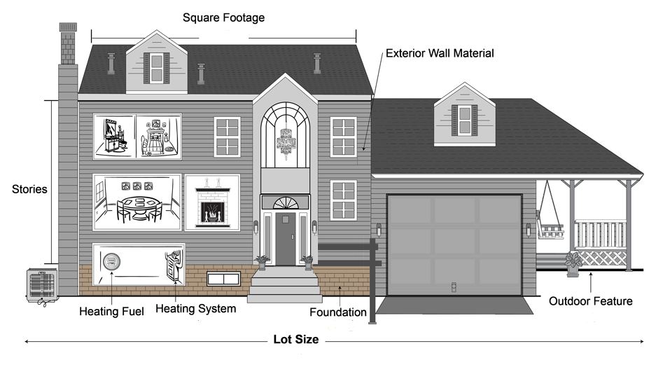
Tax Assessment and Sales
-Year built -Sale date -Sale price -Assessed value -Property tax
and rooms
and zoning

Slide 8
Local Administrative Data Research
The reality
Census MAF
Local Admin
Census MAF
AHS
Local Admin
AHS

Slide 9
Local Administrative Data Research
AHS Number of Units | AHS to Local Admin Match Rate | Share of AHS Cases
Single family | 79% | 74%
Duplex | 20% | 4%
Small multifamily (3-4 unit building) | 13% | 4%
Large multifamily (5+ unit building) | 14% | 18%
Net Result: 62% of AHS cases can be matched to local admin
Lesson #1: Develop better ways of matching multifamily
Lesson #2: Be prepared for data integration with partial sample

Slide 10
Commercial “Like Administrative” Data Sources
Automated Valuation Model
Multiple Listing Service
Mortgage
Foreclosure 77% match rate with MAF
Utility

